Slide 1
Project presentation #2 Iris

Slide 2
TABLE OF CONTENTS
TABLE OF CONTENTS
PRODUCT OVERVIEW
Simple linear model
Simple Linear Regression Model
Residual
SSE/RRS
OLS model
1
2
3
4
5

Slide 3
MODEL
Model is a simplified representation of reality that help us understand, predict or make decisions based on the graph or data.
A basic Model consists of : formula + algorithms + data
It describes input and output relationship
Not all model in linear relationship( linear or nonlinear relationship)

Slide 4
Why sales vs TV?
Because we always compare features to itself.
Sales vs TV clearly shows how TV spending affect sales by using data.
We use correlation that proved they has strong, stable linear relationship.
TV vs Sales involve the most linear relationship compare to other features. But sales are the strongest under the influence of TV, it might occurs the situation that other features assist TV to become the strongest because customs might want to watch TV and listen Radio at the same time—-共振协和reaction.
when they advertise at same time, then TV vs Sales is the strongest linear relation—-We need to prove in mathematical indicator.

Slide 5
Simple linear regression model
We use correlation that proved they has strong, stable linear relationship.
Simple linear regression model is to describe a linear relationship, based on relative and always has deviation, not perfect linear.
Linear Regression model consist of:
Linear: linearity, describe dependent and independent variable in a straight line relationship.
Regression: moving closer to the average line, use to examine relationship between variables, whether linear or nonlinear

Slide 6
Why do we need to build the model?
We don’t need to perfect linear relations, we just need best fit that might involve variation and deviation.
We need build this model based on mathematical indicator solution(Calculus) to tell us best answer/optimal solution

Slide 7


Simple Linear regression model
Y=ax+b
Y=target(predict always in Y-axis)
a=coefficient/slope/ weight(in AI)
x=feature
b=intercept/bias(in AI)
Formula: Y=Weight x Feature + Bias
*Why is simple linear regression model?
—only 1 feature
^yi= predicted value
xi=feature
=intercept
=slope

Slide 8
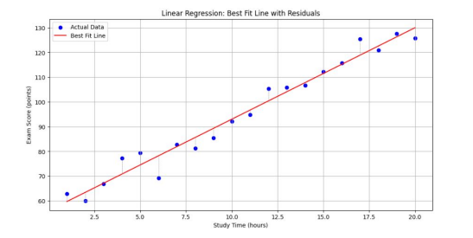

Residual
ei=yi-^yi
*what type of model we need to find?
Have to find least Residual for a good model
Find the optimal number for beta 1 and beta 0
Find distance between point(yi) and approx.linear equation(^y)

Slide 9

SSE/RSS
SSE=Sum of Squared Error
RSS=Residual Sum of Square
Formula:
S/J(Beta0,Beta1) : cost function,
adjust beta 0 and beta 1 to become new cost function
*why is squared:
eliminate all the negative value to be positive and find the real error
Find smallest error and find best data( use calculus/derivative)

Slide 10
OLS MODEL
Original Least Square model:
Minimize the sum of squared differences between observed and predicted values, and obtain a straight line closer to data points
Cost Function(add RSS together)
To find the optimal number of coefficient—-create the least residual by using SSE

Slide 11
Calculus
Derivation ： y=(x^n)
y’=(nx)^n-1
When Derivation=0, means local minimum or maximum
Constant term = 0
Slope: m= x/ y
Linear– rate of change
Curve–average rate of change
—minimum, infinite to point of slope
Chain rule: f(g(x))
–calculate derivation of both f(x) and g(x)
–f(x) * g(x)

Slide 12
Thank u !

